Slide 1

Rides Analysis
Presented by: Tkhoruk Ihor
Last Updated: September 10th, 2022

Slide 2
Plan
Objective
Data Insights
Conclusions

Slide 3

Objective
Find where and when there were the most potential members

Slide 4
Data Insights

Slide 5
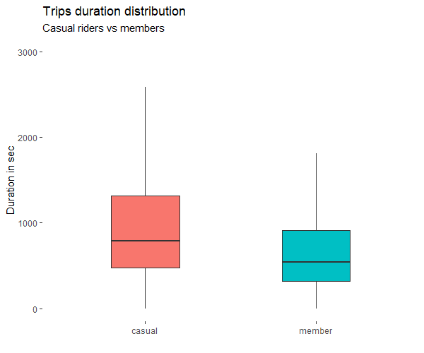
Difference between casuals and members
Casual’s rides is longer than member’s rides
Data is needed to identify potential members among casuals
All casuals will be considered potential members in this analysis
881
548

Slide 6
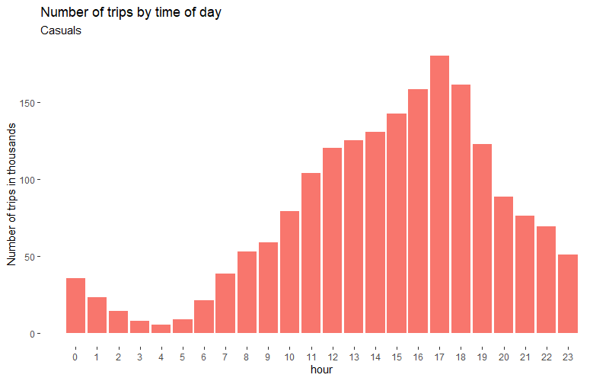
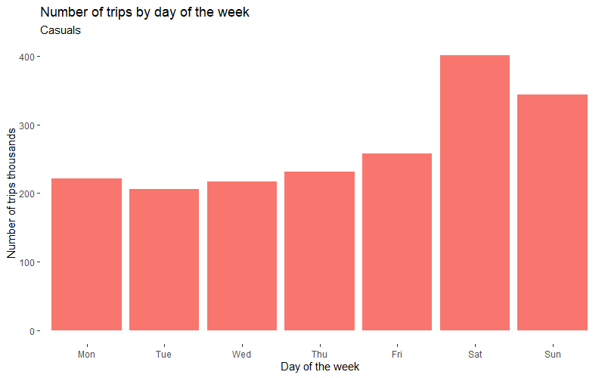
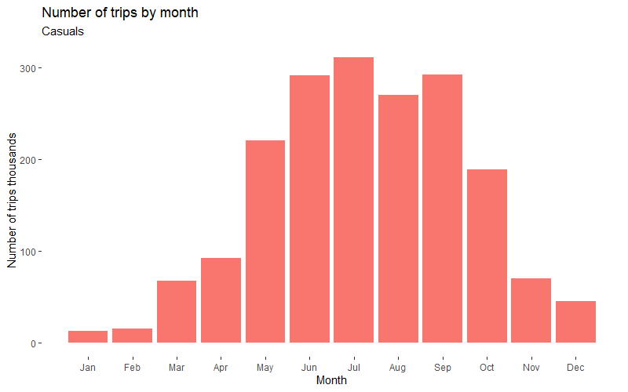
When were the most potential members?
The best time is between 12 and 19
The best weekdays are Saturday and Sunday
The best months are June, July, August and September

Slide 7
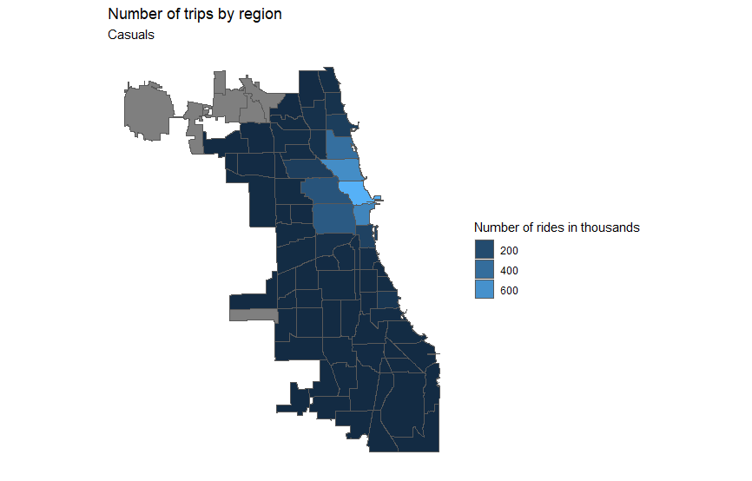
Where were the most potential members?
The most potential members were in Near North Side, Lincoln Park, Loop and Lake View regions

Slide 8
Conclusions

Slide 9
Conclusions
Casual’s trips is longer in average then member’s trips
The best time to advertise membership is between June and September at the weekend between 12 and 19 o'clock
The best regions to advertise membership are Near North Side, Lincoln Park, Loop and Lake View.

Slide 10
Thank you

